Slide 1
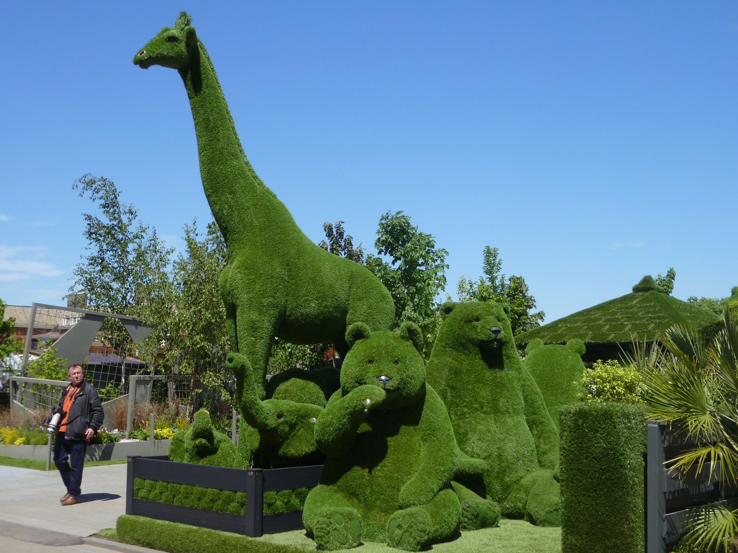
What’s green got to do with it?

Slide 2
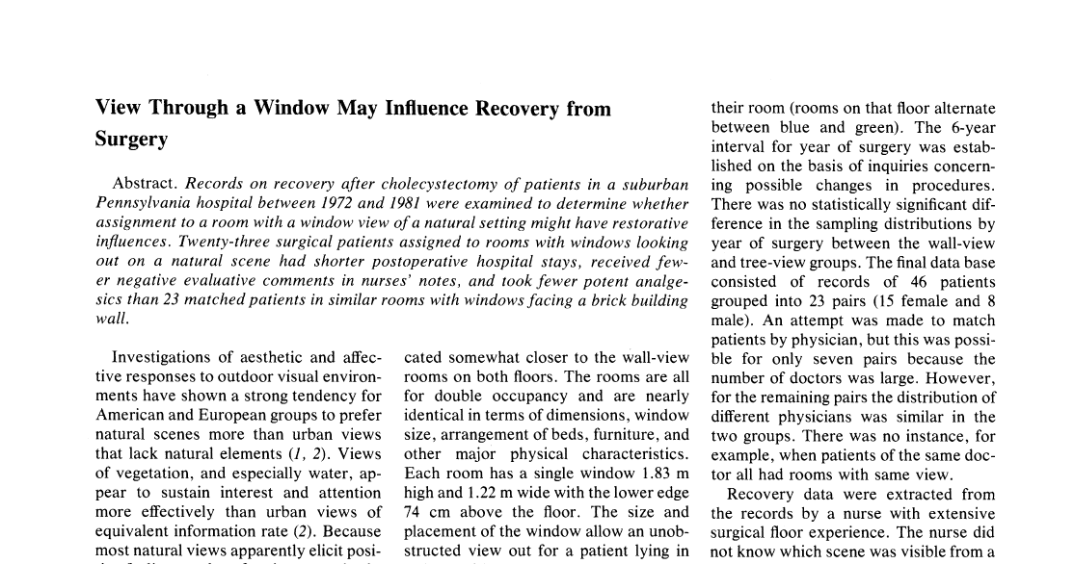
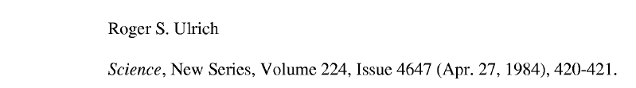

Slide 3
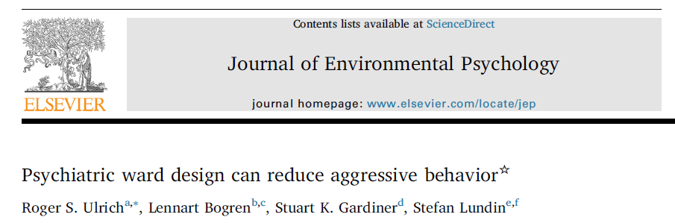
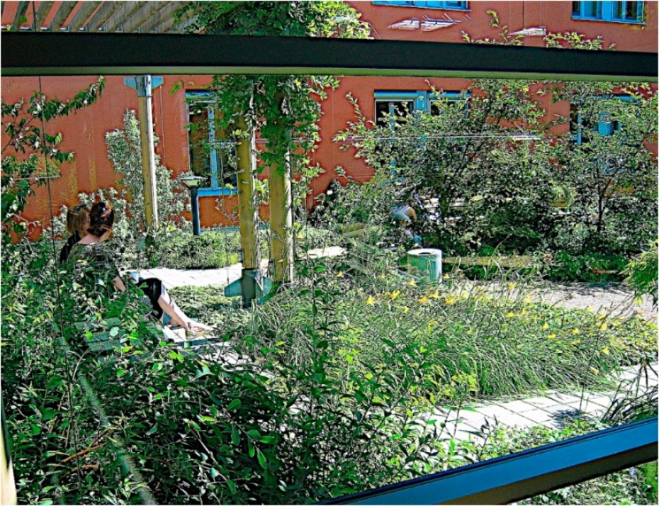

Slide 4
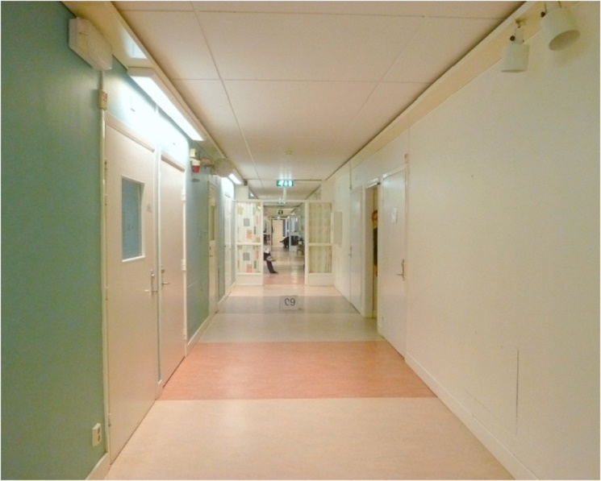
Notes:
50 % less restraint in hospital specifically designed with stress-reducing features

Slide 5
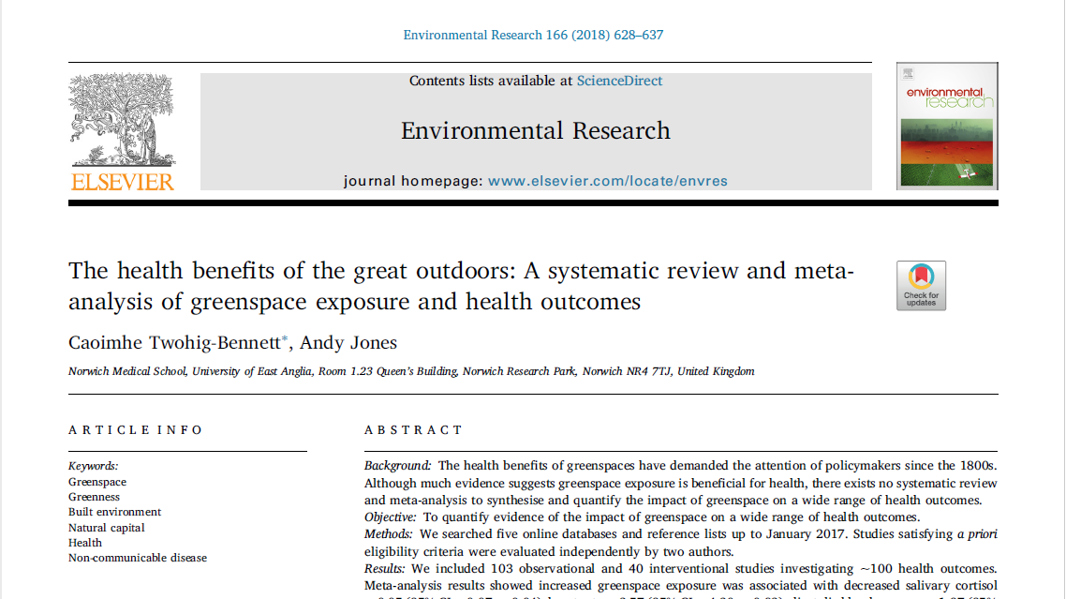
Notes:
96 % of studies in last 10 years

Slide 6
self-reported health
type II diabetes
all-cause and cardiovascular mortality
diastolic blood pressure
salivary cortisol
heart rate
heart rate variability
HDL cholesterol
preterm birth
small size for gestational age births

Slide 7
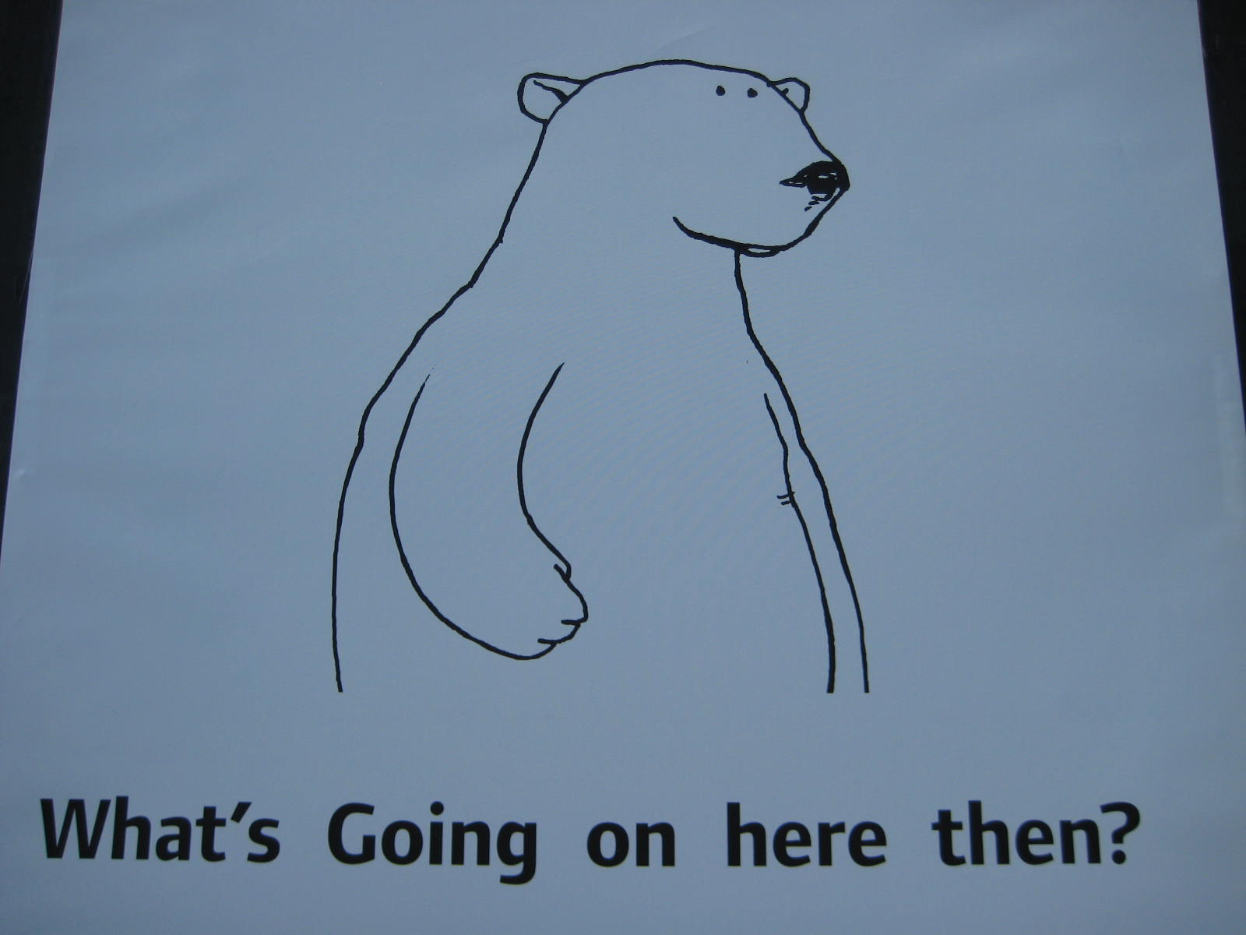
Notes:
Pollution and poverty

Slide 8
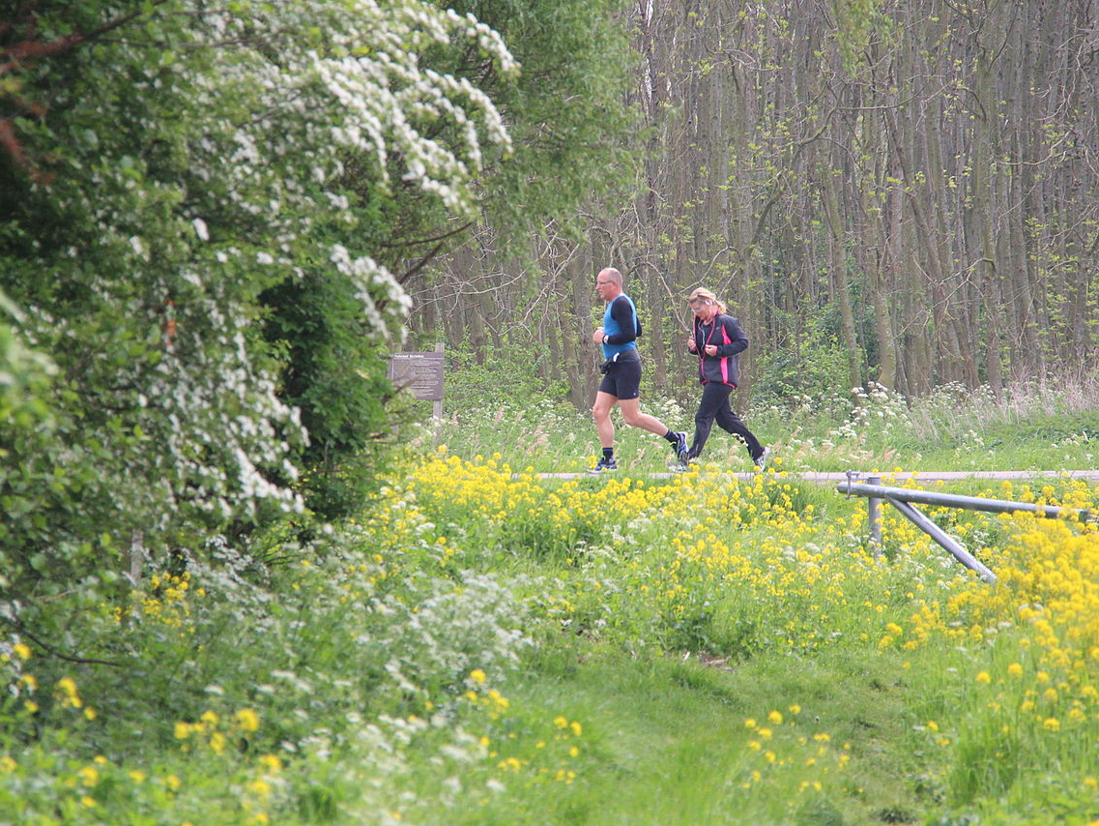
Is it just exercise?
By Peter van der Sluijs - Own work, CC BY-SA 3.0, https://commons.wikimedia.org/w/index.php?curid=32302277

Slide 9
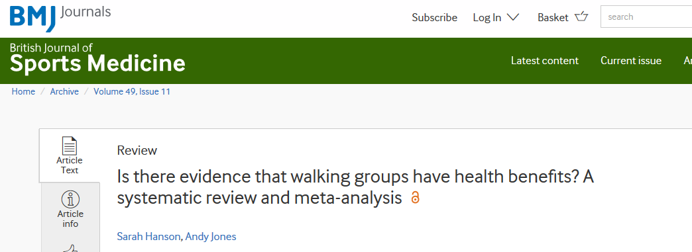
‘This systematic review and meta-analysis provides evidence that outdoor walking groups have health benefits over and above making people more physically active’

Slide 10
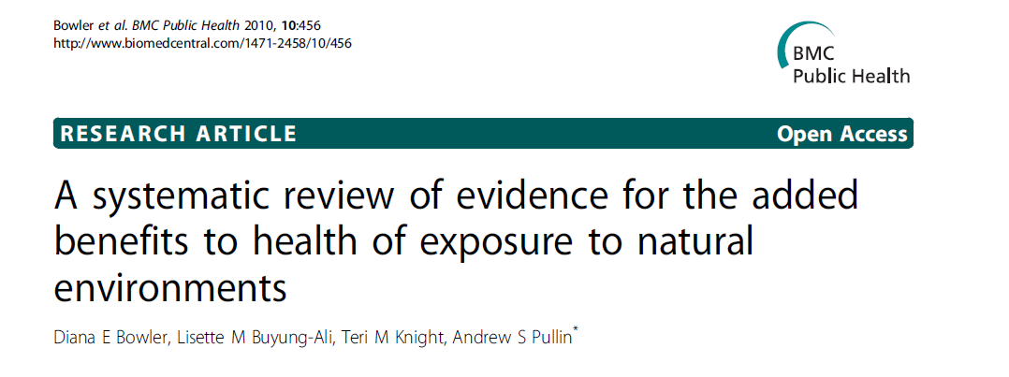
‘evidence of a positive benefit of a walk or run in a natural environment in comparison to a synthetic environment.’
‘The evidence was weaker for any ‘added value’ of exposure to a natural environment on physiological outcomes, however few studies were available for analysis.’

Slide 11
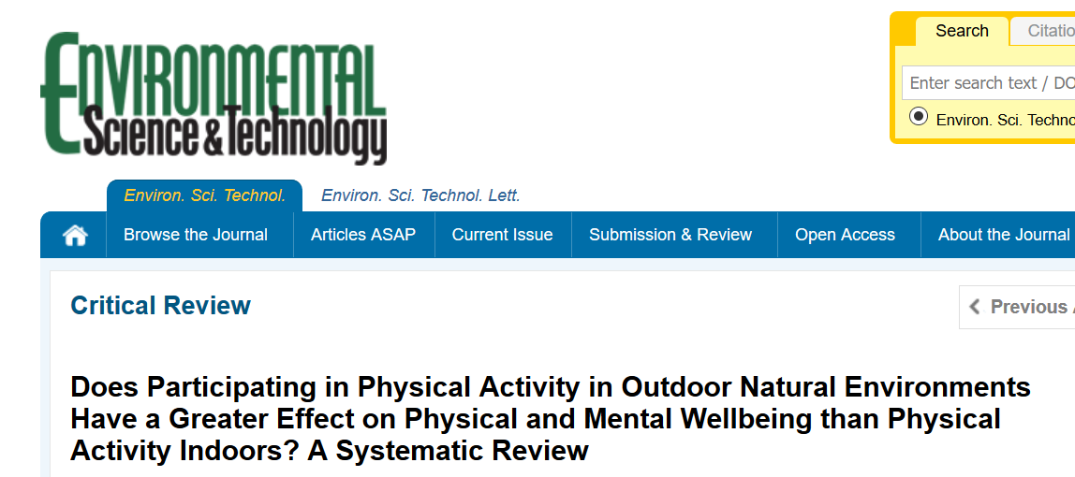
‘some promising effects on self-reported mental wellbeing immediately following exercise in nature which are not seen following the same exercise indoors’

Slide 12
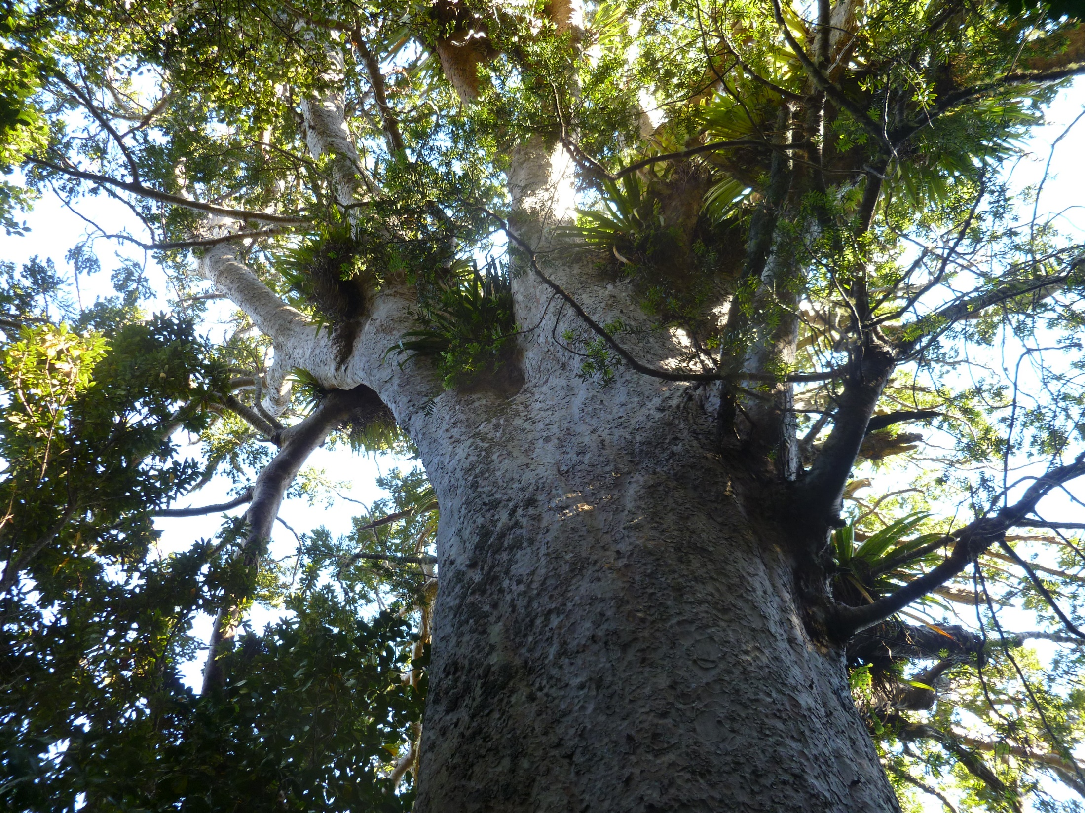
Do we need trees?
Notes:
Important point: in majority of studies, greenspace studied is actually some kind of woodland.

Slide 13
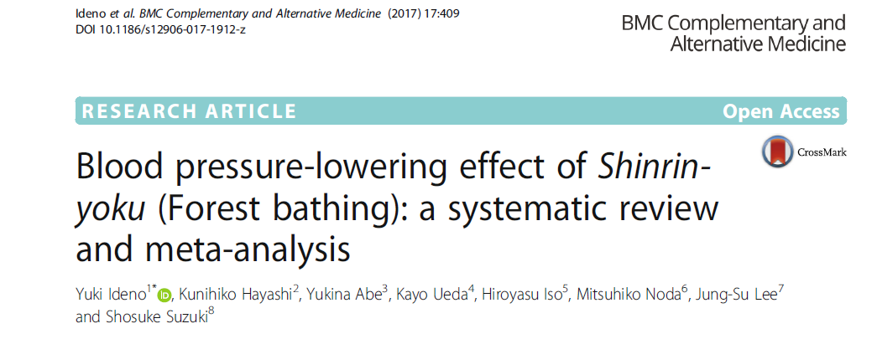
‘The results of meta-analysis showed that SBP and DBP of the forest environment were significantly lower than those of the non-forest environment.’
‘[comparison of] walking … and non-walking …. suggests that the effect of the forest environment on blood pressure is not due to physical activity.’
Notes:
Trials compared walking in forest areas (11 trials), and sitting and viewing forest landscapes (7 trials), with the same activities in non-forest environment-like city areas (13 trials), with sitting in a room (4 trials), or with measuring blood pressure in daily life (2 trials).

Slide 14
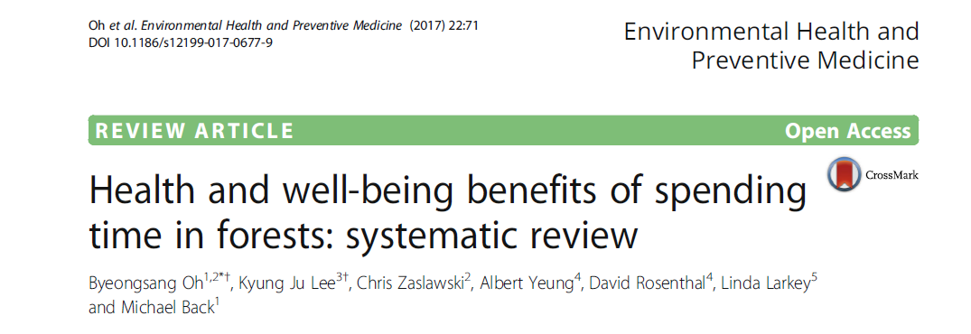
‘… promising therapeutic benefits of forest exposure on several physical and psychological conditions including hypertension, cardiac and pulmonary function, immune function, inflammation, oxidative stress, stress, stress hormone, anxiety, depression, and emotional response.’
But only six studies, most with ‘risk of bias, low sample sizes, and lack of control for participant expectation effects’

Slide 15
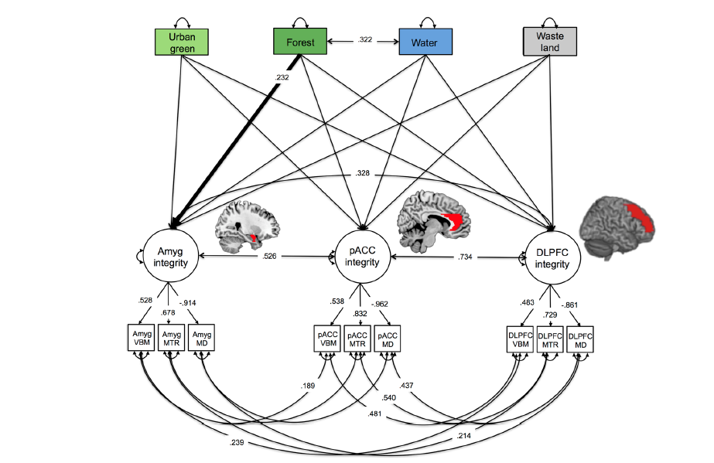
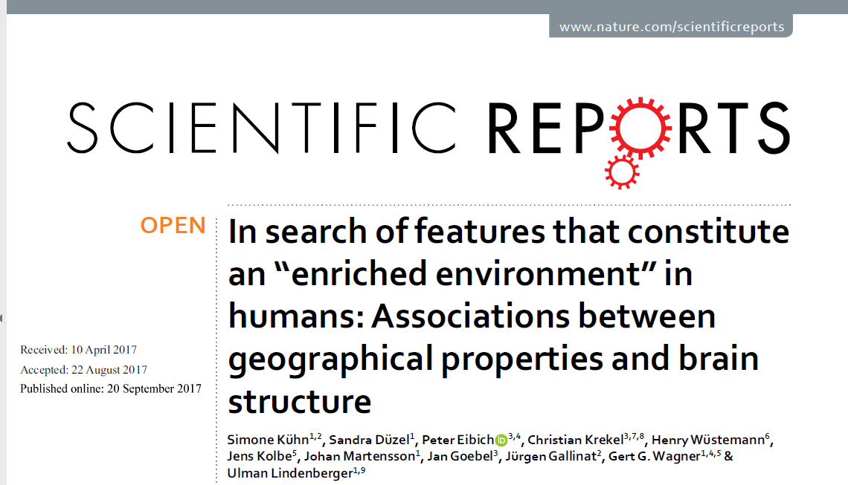
‘Our results reveal a significant positive association between the coverage of forest and amygdala integrity’

Slide 16
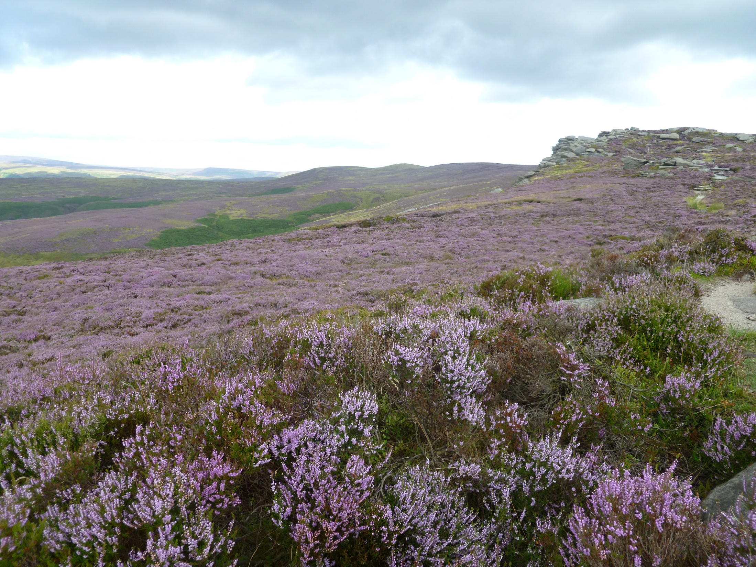
What about biodiversity?

Slide 17
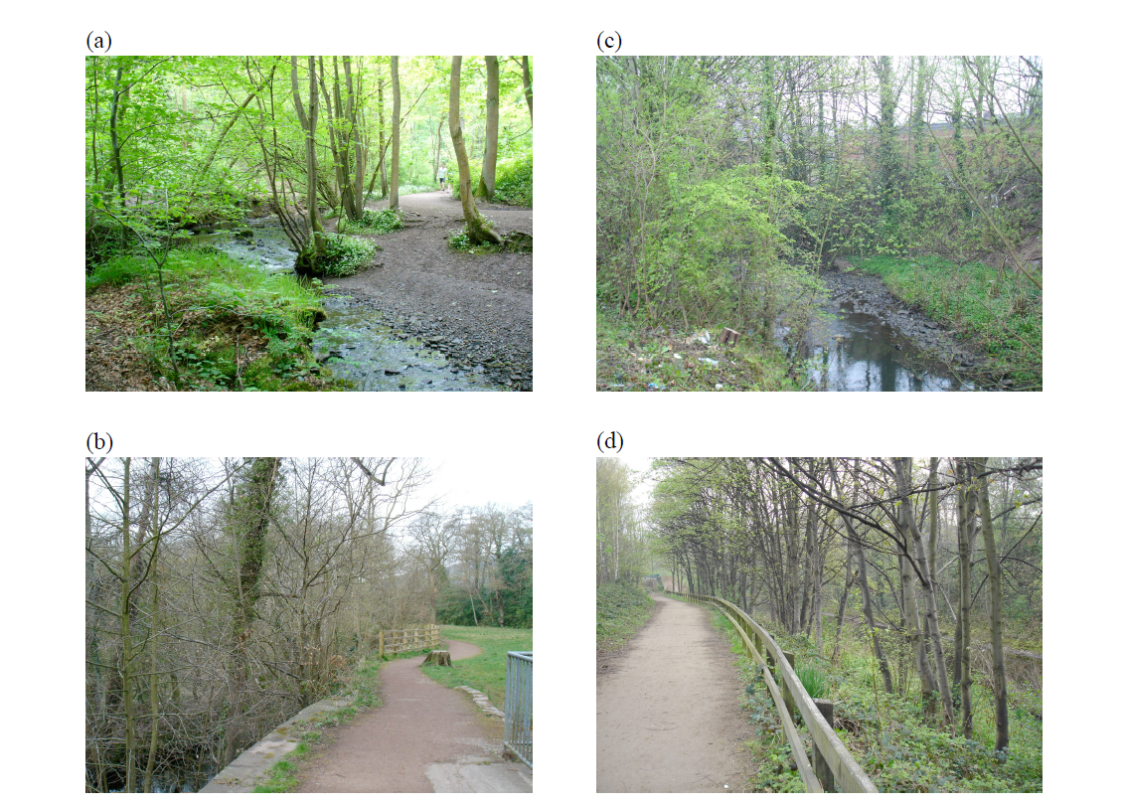
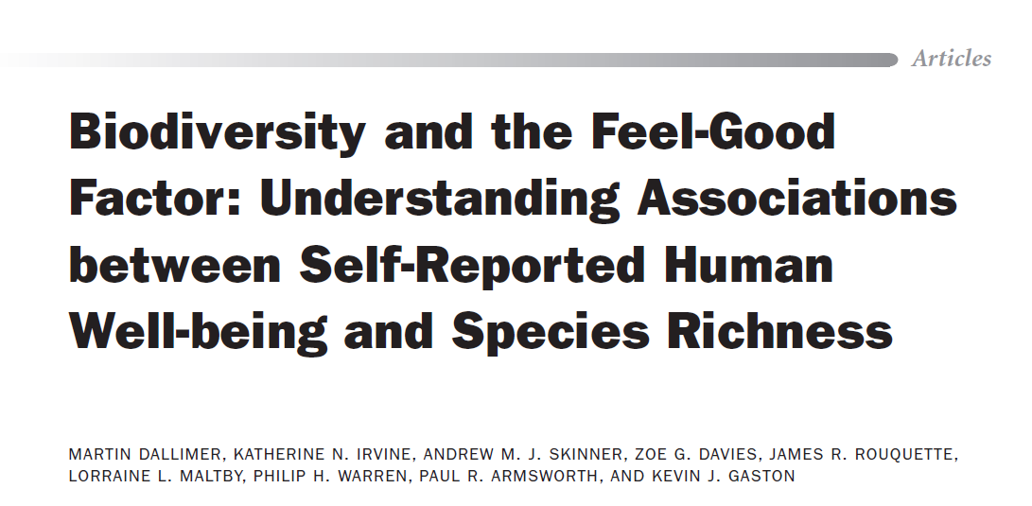

Slide 18
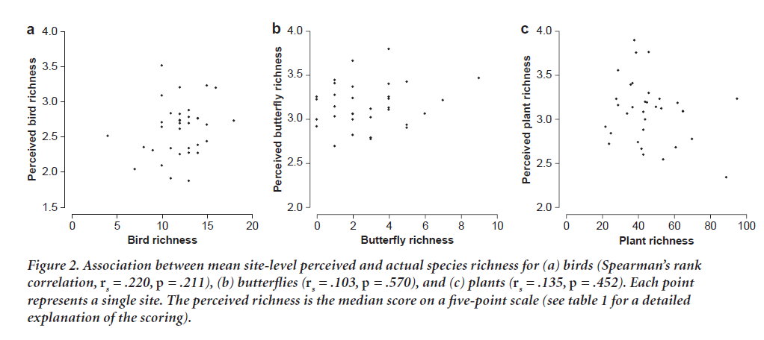
Notes:
French study

Slide 19
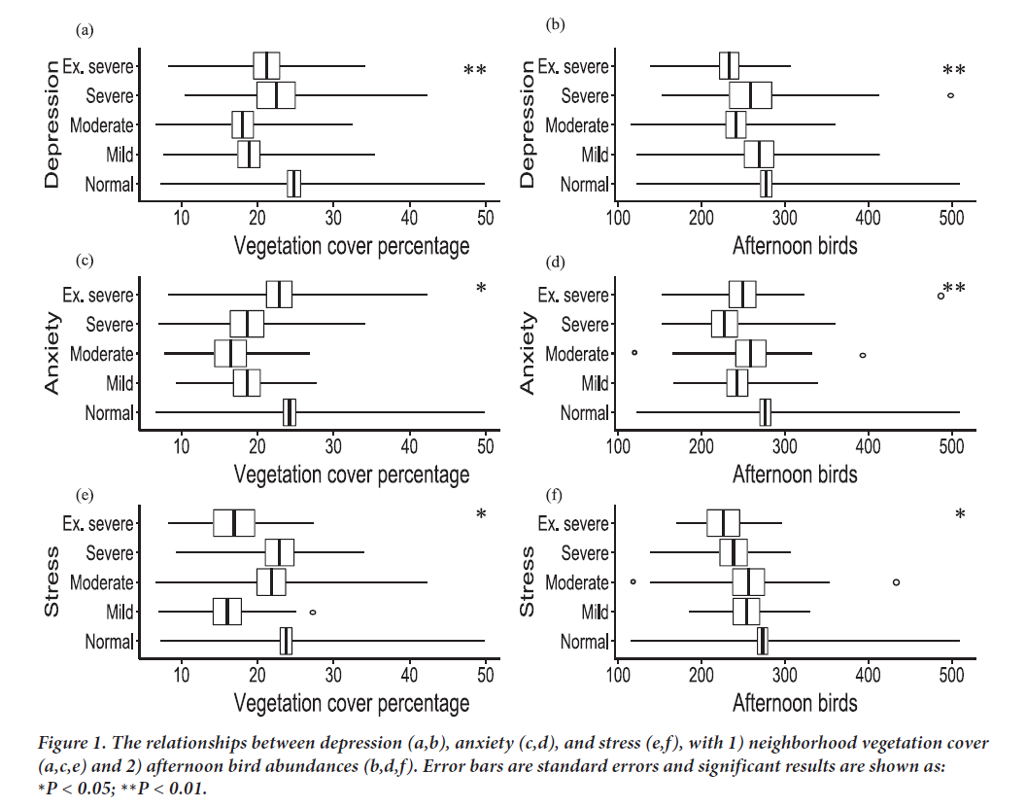
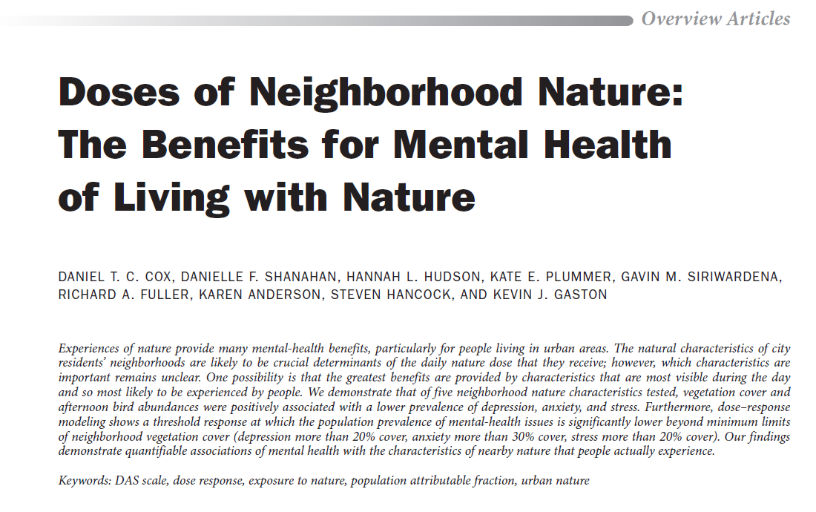
Notes:
But no effect of actual bird abundance, or richness at any time.

Slide 20
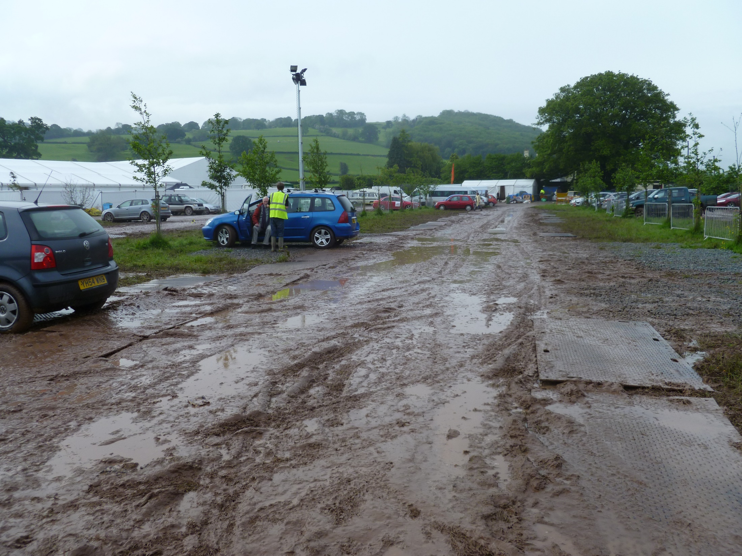
The hygiene hypothesis

Slide 21
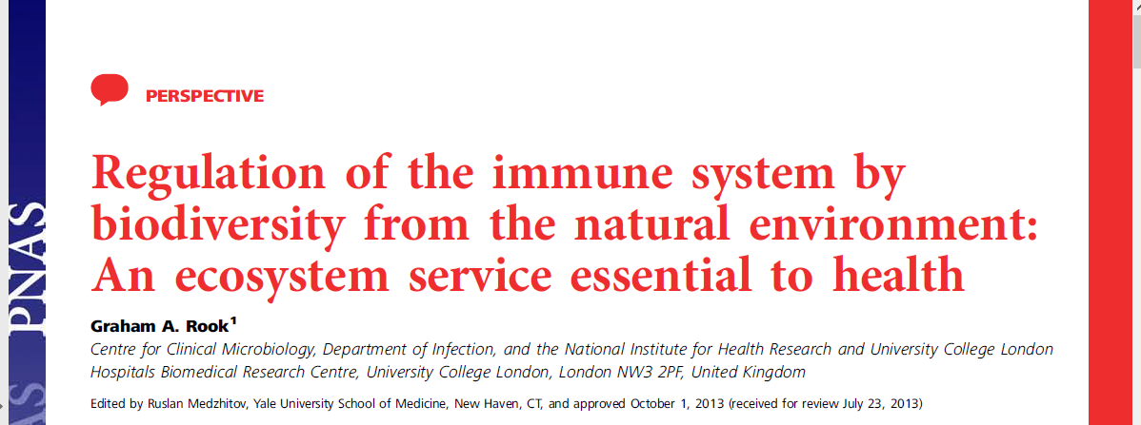

Slide 25
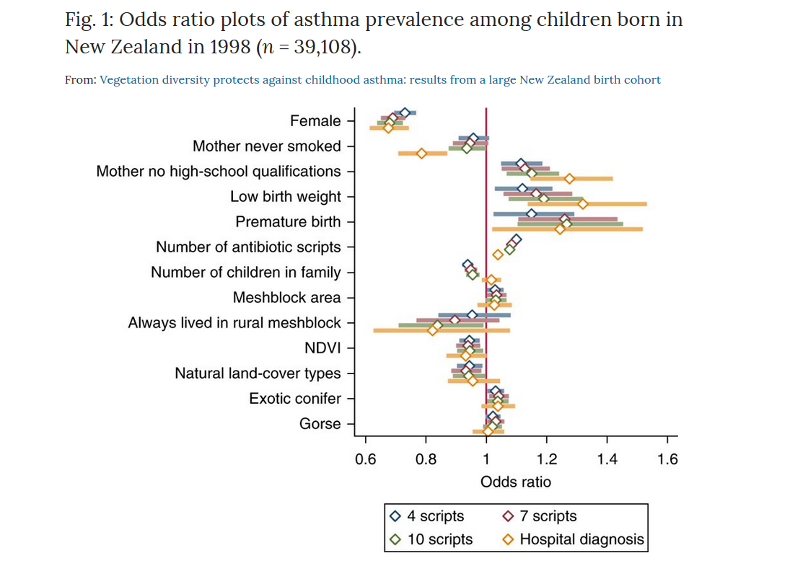
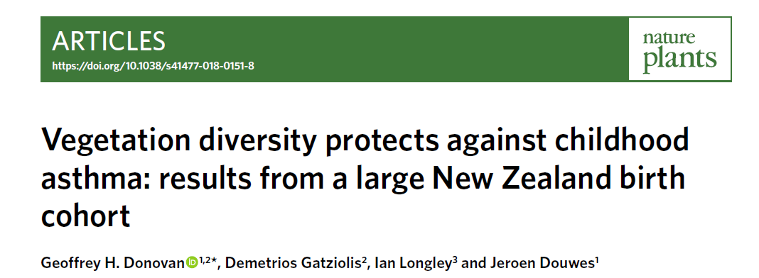

Slide 26
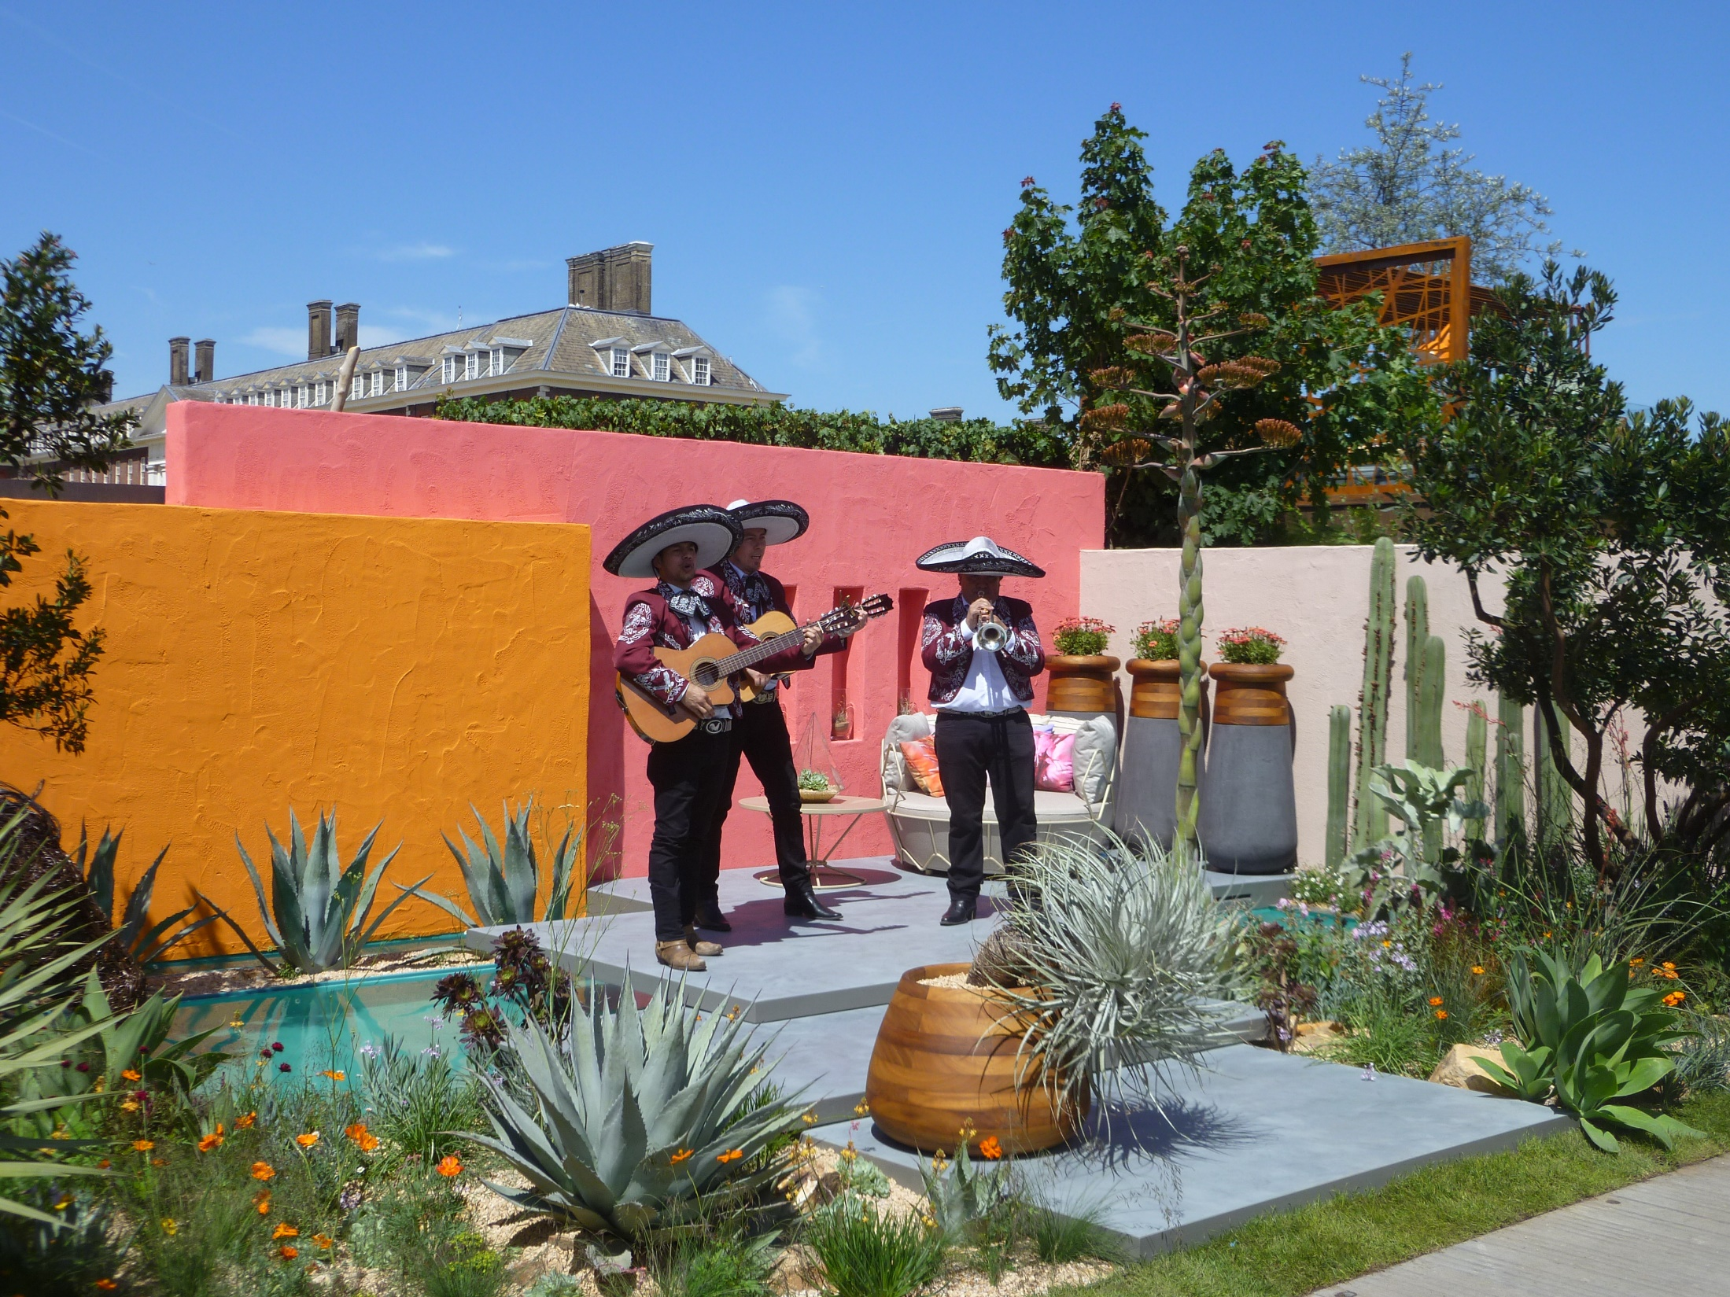
Gardens – and gardening

Slide 27
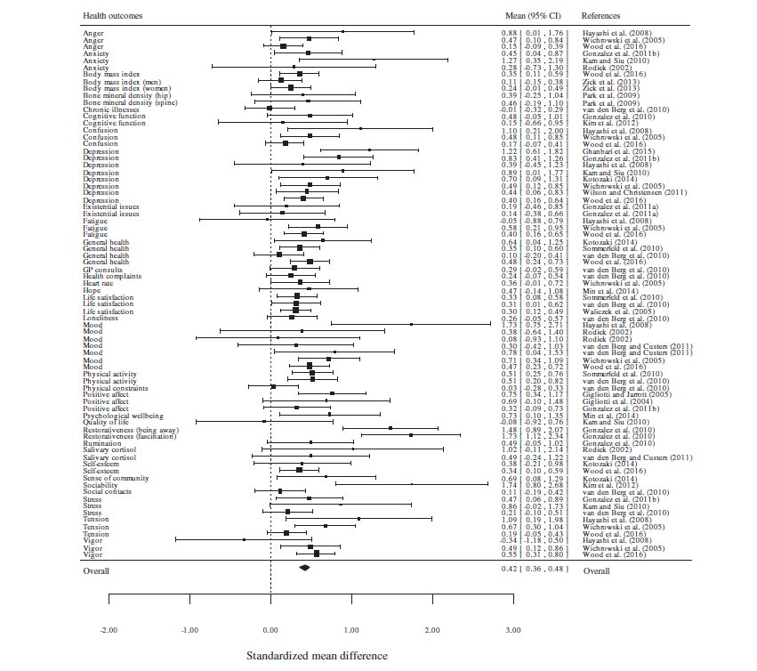
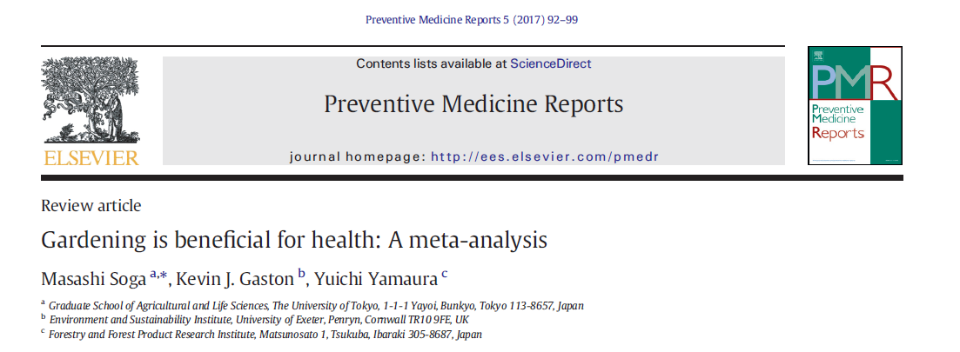

Slide 28
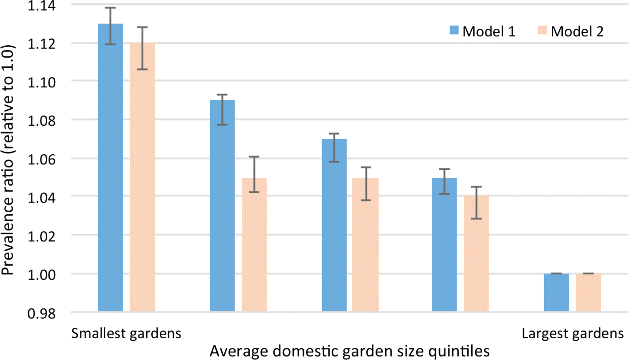
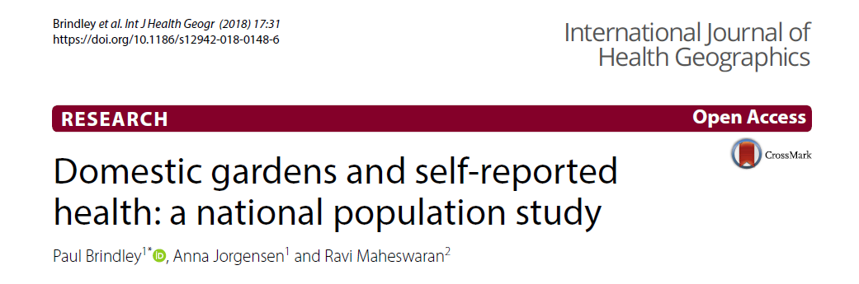

Slide 29
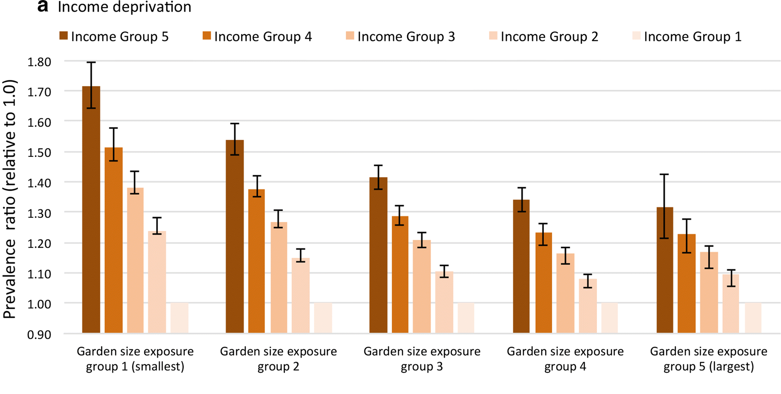
Notes:
But not other urban green space

Slide 30
Some tentative conclusions
Greenspace is good, but gardens are better than other kinds of greenspace.
Exercise is good for you, but greenspace has effects beyond exercise.
Microbial biodiversity is important, but effect of the biodiversity you actually notice remains obscure.
Trees are important.

Slide 31
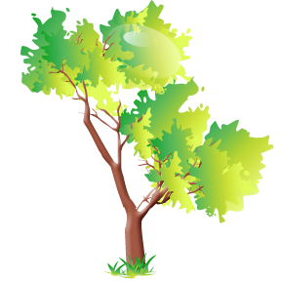
Loram, A., P.H. Warren, and K.J. Gaston (2008) Urban domestic gardens (XIV): The characteristics of gardens in five cities. Environmental Management, 42, 361-376

Slide 32
Countryside
Towns and cities

Slide 33
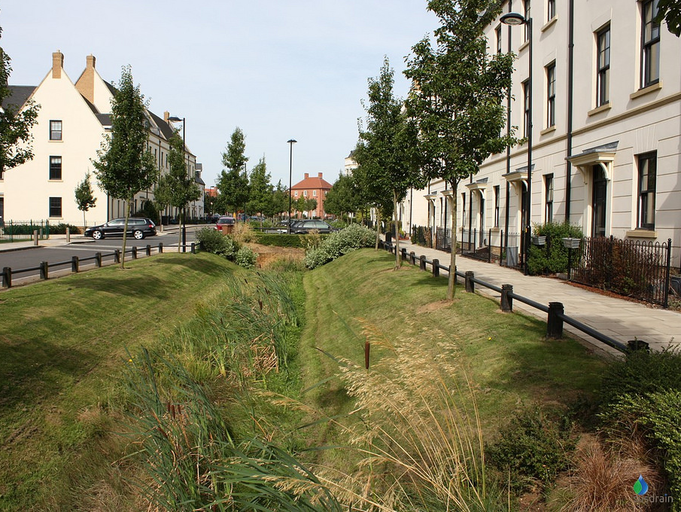

Slide 34
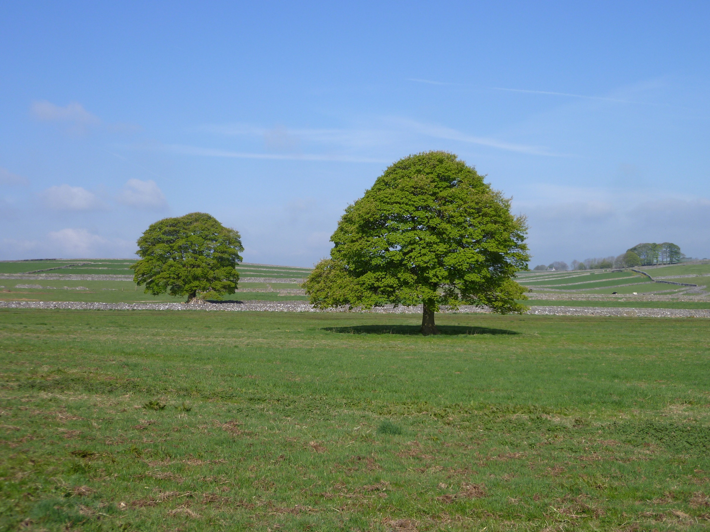
Thank you

